Slide 1

Chapter 8 – Software Testing
Chapter 8 Software testing

Slide 2
Program testing
Testing is intended to show that a program does what it is intended to do and to discover program defects before it is put into use.
When you test software, you execute a program using artificial data.
You check the results of the test run for errors, anomalies or information about the program’s non-functional attributes.
Can reveal the presence of errors NOT their absence.
Testing is part of a more general verification and validation process, which also includes static validation techniques.
Chapter 8 Software testing

Slide 3
Program testing goals
To demonstrate to the developer and the customer that the software meets its requirements.
For custom software, this means that there should be at least one test for every requirement in the requirements document. For generic software products, it means that there should be tests for all of the system features, plus combinations of these features, that will be incorporated in the product release.
To discover situations in which the behavior of the software is incorrect, undesirable or does not conform to its specification.
Defect testing is concerned with rooting out undesirable system behavior such as system crashes, unwanted interactions with other systems, incorrect computations and data corruption.
Chapter 8 Software testing

Slide 4
Validation and defect testing
The first goal leads to validation testing
You expect the system to perform correctly using a given set of test cases that reflect the system’s expected use.
The second goal leads to defect testing
The test cases are designed to expose defects. The test cases in defect testing can be deliberately obscure and need not reflect how the system is normally used.
Chapter 8 Software testing

Slide 5
Testing process goals
Validation testing
To demonstrate to the developer and the system customer that the software meets its requirements
A successful test shows that the system operates as intended.
Defect testing
To discover faults or defects in the software where its behaviour is incorrect or not in conformance with its specification
A successful test is a test that makes the system perform incorrectly and so exposes a defect in the system.
Chapter 8 Software testing

Slide 6
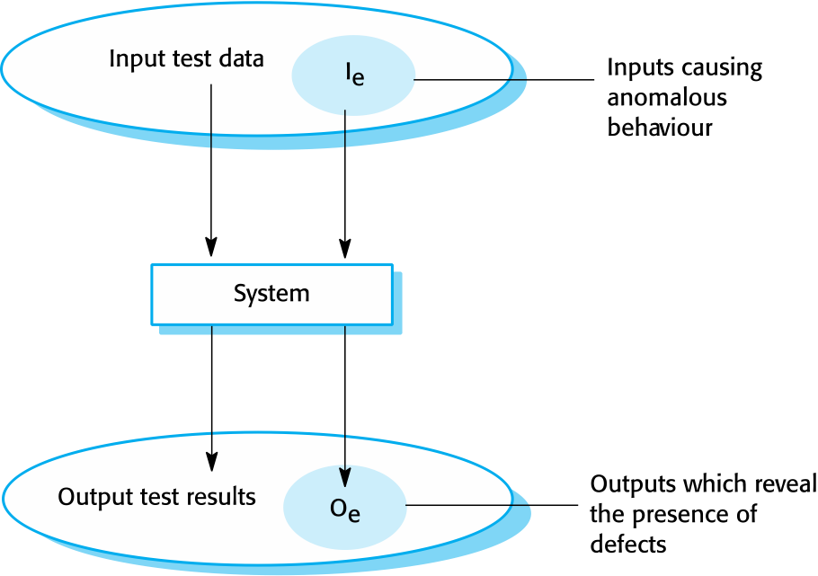
An input-output model of program testing
Chapter 8 Software testing

Slide 7
Verification vs validation
Verification: "Are we building the product right”.
The software should conform to its specification.
Validation: "Are we building the right product”.
The software should do what the user really requires.
Chapter 8 Software testing

Slide 8
Inspections and testing
Software inspections Concerned with analysis of the static system representation to discover problems (static verification)
May be supplement by tool-based document and code analysis.
Discussed in Chapter 15.
Software testing Concerned with exercising and observing product behaviour (dynamic verification)
The system is executed with test data and its operational behaviour is observed.
Chapter 8 Software testing

Slide 9
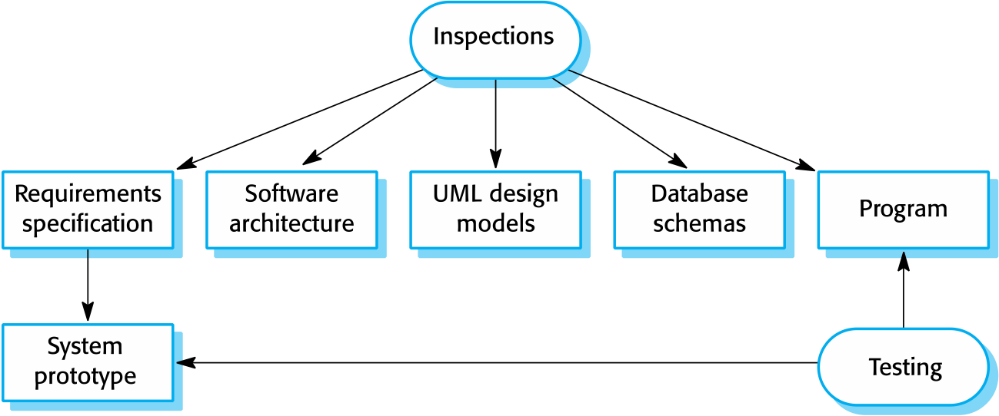
Inspections and testing
Chapter 8 Software testing

Slide 10
Software inspections
These involve people examining the source representation with the aim of discovering anomalies and defects.
Inspections not require execution of a system so may be used before implementation.
They may be applied to any representation of the system (requirements, design, configuration data, test data, etc.).
They have been shown to be an effective technique for discovering program errors.
Chapter 8 Software testing

Slide 11
Advantages of inspections
During testing, errors can mask (hide) other errors. Because inspection is a static process, you don’t have to be concerned with interactions between errors.
Incomplete versions of a system can be inspected without additional costs. If a program is incomplete, then you need to develop specialized test harnesses to test the parts that are available.
As well as searching for program defects, an inspection can also consider broader quality attributes of a program, such as compliance with standards, portability and maintainability.
Chapter 8 Software testing

Slide 12
Automated static analysis checks
Fault class | Static analysis check
Data faults | Variables used before initialization Variables declared but never used Variables assigned twice but never used between assignments Possible array bound violations Undeclared variables
Control faults | Unreachable code Unconditional branches into loops
Input/output faults | Variables output twice with no intervening assignment
Interface faults | Parameter-type mismatches Parameter number mismatches Non-usage of the results of functions Uncalled functions and procedures
Storage management faults | Unassigned pointers Pointer arithmetic Memory leaks
Chapter 15 Dependability and Security Assurance

Slide 13
Inspections and testing
Inspections and testing are complementary and not opposing verification techniques.
Both should be used during the V & V process.
Inspections can check conformance with a specification but not conformance with the customer’s real requirements.
Inspections cannot check non-functional characteristics such as performance, usability, etc.
Chapter 8 Software testing

Slide 14
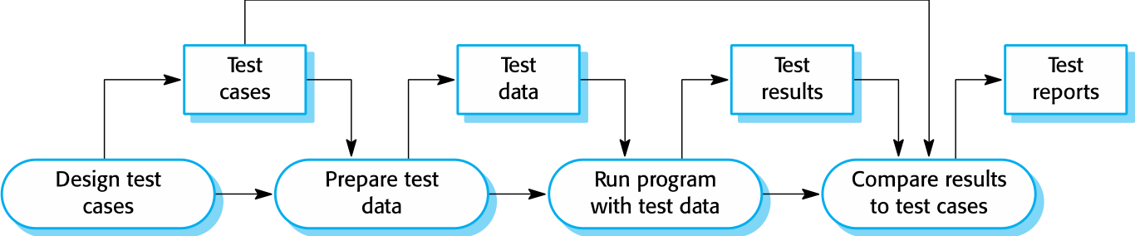
A model of the software testing process
Chapter 8 Software testing

Slide 15
Test data and test cases
Test data Inputs which have been devised to test the system
Test cases Inputs to test the system and the predicted outputs from these inputs if the system operates according to its specification

Slide 16
Choosing test case
Black-box testing
An approach to testing where the program is considered as a ‘black-box’
The program test cases are based on the system specification
White-box testing
Derivation of test cases according to program structure.
Knowledge of the program is used to identify additional test cases

Slide 17
Stages of testing
Development testing, where the system is tested during development to discover bugs and defects.
Release testing, where a separate testing team test a complete version of the system before it is released to users.
User testing, where users or potential users of a system test the system in their own environment.
Chapter 8 Software testing

Slide 18
Development testing
Development testing includes all testing activities that are carried out by the team developing the system.
Unit testing, where individual program units or object classes are tested. Unit testing should focus on testing the functionality of objects or methods.
Component testing, where several individual units are integrated to create composite components. Component testing should focus on testing component interfaces.
System testing, where some or all of the components in a system are integrated and the system is tested as a whole. System testing should focus on testing component interactions.
Chapter 8 Software testing

Slide 19
Unit testing
Unit testing is the process of testing individual components in isolation.
It is a defect testing process.
Units may be:
Individual functions or methods within an object
Object classes with several attributes and methods
Composite components with defined interfaces used to access their functionality.
Chapter 8 Software testing

Slide 20
Object class testing
Complete test coverage of a class involves
Testing all operations associated with an object
Setting and interrogating all object attributes
Exercising the object in all possible states.
Inheritance makes it more difficult to design object class tests as the information to be tested is not localised.
Chapter 8 Software testing

Slide 21
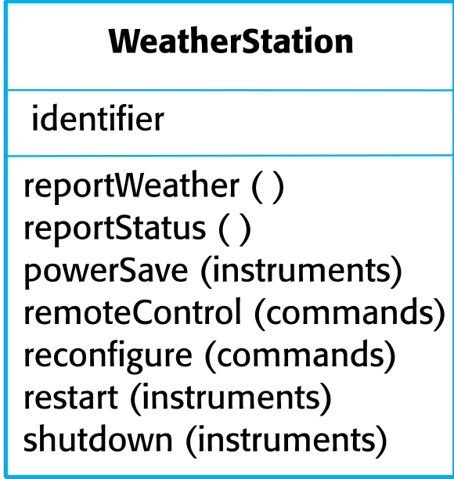
The weather station object interface
Chapter 8 Software testing

Slide 22
Weather station testing
Need to define test cases for reportWeather, calibrate, test, startup and shutdown.
Using a state model, identify sequences of state transitions to be tested and the event sequences to cause these transitions
For example:
Shutdown -> Running-> Shutdown
Configuring-> Running-> Testing -> Transmitting -> Running
Running-> Collecting-> Running-> Summarizing -> Transmitting -> Running
Chapter 8 Software testing

Slide 23
Automated testing
Whenever possible, unit testing should be automated so that tests are run and checked without manual intervention.
In automated unit testing, you make use of a test automation framework (such as JUnit) to write and run your program tests.
Unit testing frameworks provide generic test classes that you extend to create specific test cases. They can then run all of the tests that you have implemented and report, often through some GUI, on the success of otherwise of the tests.
Chapter 8 Software testing

Slide 24
Automated test components
A setup part, where you initialize the system with the test case, namely the inputs and expected outputs.
A call part, where you call the object or method to be tested.
An assertion part where you compare the result of the call with the expected result. If the assertion evaluates to true, the test has been successful if false, then it has failed.
Chapter 8 Software testing

Slide 25
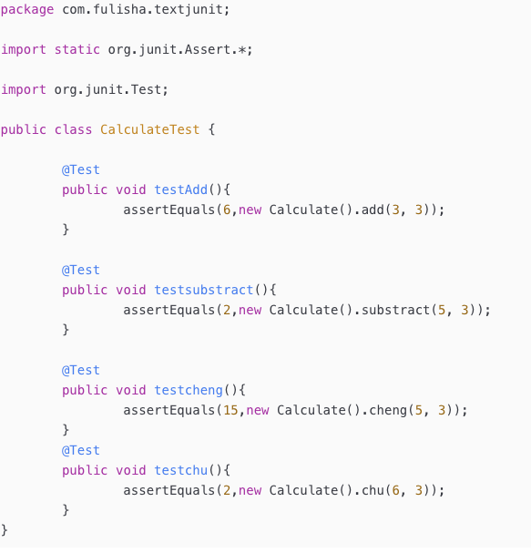
Automatic unit testing

Slide 26
Some Tools for automatic testing
Selenium :Browse testing
QTP(HP QuickTest Professional software ): for regression testing
WinRunner: for function testing
Rational robot: integrated testing tools
Advent Qengine: for web application
LoadRunner: load testing
……

Slide 27
Testing strategies
Partition testing, where you identify groups of inputs that have common characteristics and should be processed in the same way.
You should choose tests from within each of these groups.
Guideline-based testing, where you use testing guidelines to choose test cases.
These guidelines reflect previous experience of the kinds of errors that programmers often make when developing components.
Chapter 8 Software testing

Slide 28
Partition testing
Input data and output results often fall into different classes where all members of a class are related.
Each of these classes is an equivalence partition or domain where the program behaves in an equivalent way for each class member.
Test cases should be chosen from each partition.
Chapter 8 Software testing

Slide 29
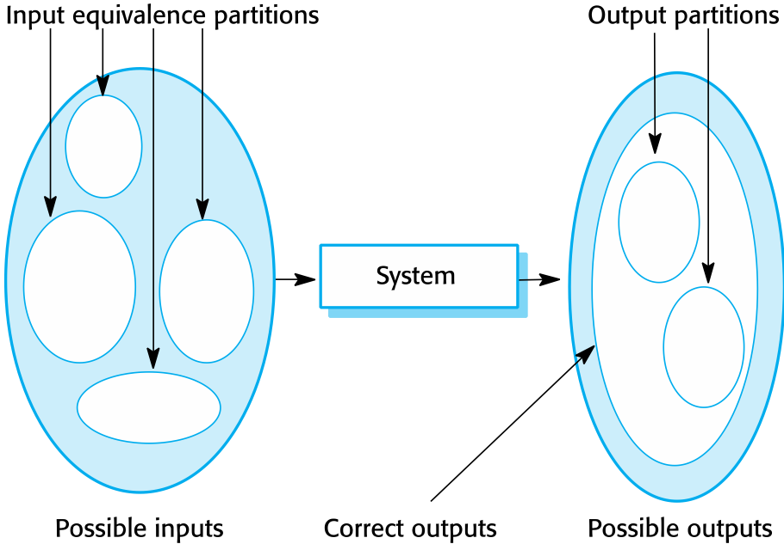
Equivalence partitioning
Chapter 8 Software testing

Slide 30
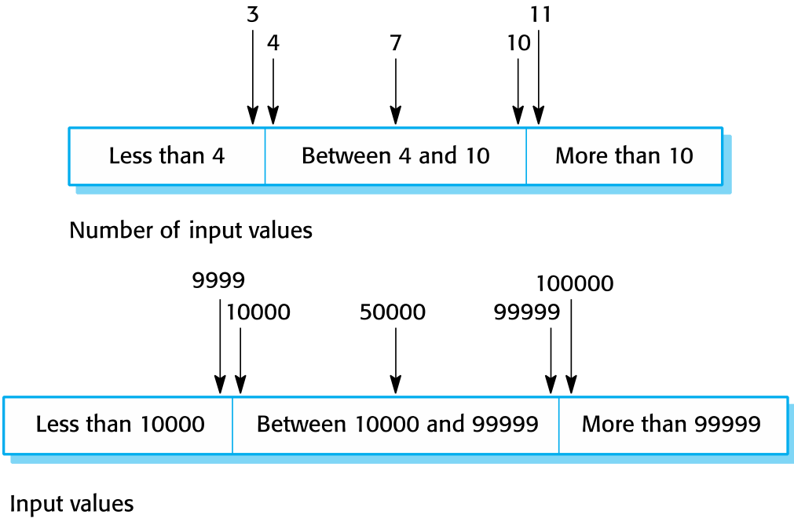
Equivalence partitions
Chapter 8 Software testing

Slide 31
Search routine specification
procedure Search (Key : ELEM ; T: ELEM_ARRAY;
Found : in out BOOLEAN; L: in out ELEM_INDEX) ;
Pre-condition
-- the array has at least one element
T’FIRST <= T’LAST
Post-condition
-- the element is found and is referenced by L
( Found and T (L) = Key)
or
-- the element is not in the array
( not Found and
not (exists i, T’FIRST >= i <= T’LAST, T (i) = Key ))

Slide 32
Search routine - input partitions
Inputs which conform to the pre-conditions
Inputs where the key element is a member of the array
Inputs where the key element is not a member of the array
Test software with sequences which have only a single value
Use sequences of different sizes in different tests
Derive tests so that the first, middle and last elements of the sequence are accessed
Test with sequences of zero length

Slide 33
Search routine - input partitions

Slide 34
General testing guidelines
Choose inputs that force the system to generate all error messages
Design inputs that cause input buffers to overflow
Repeat the same input or series of inputs numerous times
Force invalid outputs to be generated
Force computation results to be too large or too small.
Chapter 8 Software testing

